Slide 1

Digital Applications
Mr Butler | Unit 1 | Chapter 10

Slide 2

What we will be covering
Gaming Applications
Simulation Applications
Mobile Applications
Online Banking
Online Training
E-Commerce

Slide 3

Gaming Applications
Educational gaming applications allow users to apply their knowledge and support their learning within a virtual world.
Features such as leader boards help motivate individuals to improve their scores
Can take on different roles within the game and reflect on what happened in certain situations, enhancing learning
Electronic games played on devices including:
  Game consoles
  Mobile Phones
  Computers
Gaming has developed from the installation of discs on games consoles and playing alone to now using cloud and online multiplayer games.

Slide 4
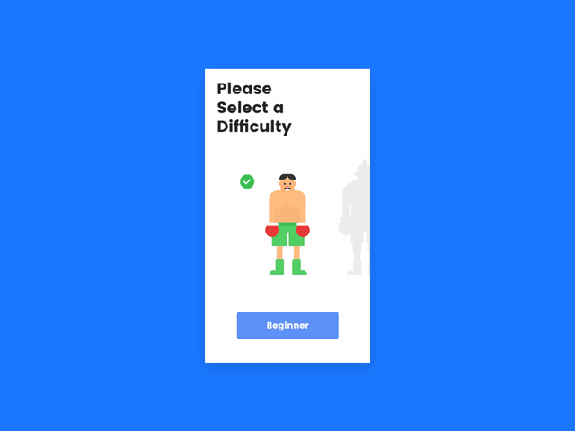


Gaming Applications
These also support training in the workplace.
Games are designed with rules and increasing levels of difficulty – the user must comply with the rules and cannot move to the next level before completing the previous.
Each level provides new challenges to the user, making games attractive for training purposes.
They also provide immediate feedback, helping users to evaluate the achievement and make decisions on what to do next.

Slide 5
The social aspect of Gaming Applications
Gaming allows users to join online gaming groups where they can compete against each other on a global scale.
They encourage collaboration as a squad can work together to solve a problem.
  Requires microphones and headsets to communicate in real time

Slide 6
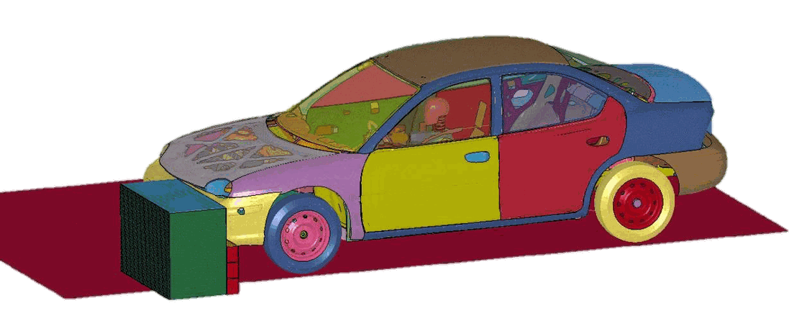
Simulation Applications
A simulation uses a computer model to represent a ‘real life’ object
  Models are created from large volumes of – along with mathematical equations – to create 3D graphics to represent the object
These objects can then be used to simulate actions and reactions of the real-life objects
  For example:
    Car crash simulations
    Architects to create models and test against flooding/earthquakes
Microsoft AI

Slide 7

Simulation Applications: Virtual Reality
Virtual Reality uses simulations to create ‘real’ experiences (virtual world)
Great potential for training people
Immersive – enters into a 3D world using specialist hardware
  Uses a range of senses such as vision, hearing and touch to make realistic.
Can be used to successfully train people for jobs with a high risk of endangering life
  i.e. training pilots to fly.
    Expensive due to fuel cost + airfares so can train for a series of different experiences.

Slide 8

Simulation example: Medical Use
Body scanners are used to collect large amounts of data about a person’s internal system
A computer can then produce a 3D model of the whole, or part of, the body – creating a ‘virtual patient’.
  This can then be used to brief or train surgeons before the ‘real’ surgery/operation
  Can plan and practise a particular operation before actually carrying it out.

Slide 9

Mobile Phone Applications
Mobile phones can access a range of apps and hence have become a key necessity in everyday life.
Great for enhancing digital communication
Users are slowly moving away from desktop computers to more mobile devices – such as laptops, tablets and mobile phones to carry out daily activities

Slide 10

Mobile Phone Applications
In the past, organisations created websites targeted at desktop users, then moved onto making the site mobile-friendly
  In recent years, companies are now interested in developing apps that can run on mobile phones instead.
  Smartphones come with pre-loaded apps and users can download further apps.

Slide 11
Mobile Applications: An Opportunity for Learning
Many applications have been designed for teaching/learning environments:
  iTunes U offers teachers opportunities to create/edit/manage online courses
    Uses videos, audio clips and books
    Combined with cloud technology, students can access these apps from home and school to complete assignments
    Can provide training programs
  Instant messaging allows users to form groups in user forums or an electronic bulletin board to communicate/share group project work

Slide 12
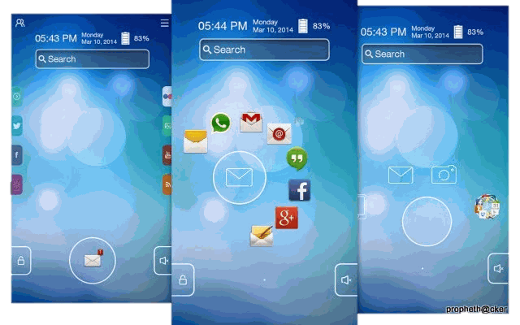
Mobile Applications: Customisation
Developers also encourage users to personalise and customise the settings and layout of the app on their device
Also have features for searching and filtering data
App support and App updates must also be provided by app developers.

Slide 13
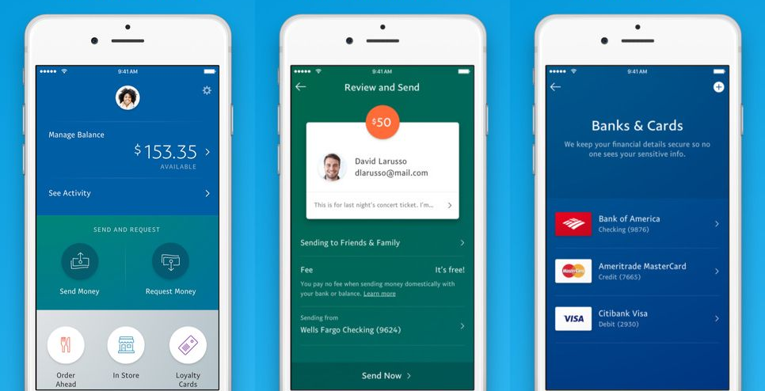
Online Banking
Online banking has become a huge aspect of the digital age.
Using the internet to access their bank account via the bank’s secure website
  Usually requires a username/password and must first register their details
  User may also be asked security questions
  Once logged in, users have access to a range of activities:
    Viewing transactions and bank statements
    Paying bills
    Transferring money
    Setting up regular payments (direct debits / standing orders)
    Searching for transactions

Slide 14


Pros and cons of Online Banking for customers
Pros | Cons
Access 24/7 as do not need to go during branches opening hours | Require access to necessary technology to access
Can access when abroad | Need computer skills / worried about fraud etc
Faster payments due to ‘faster payment services’ | No face-to-face interaction

Slide 15
Pros and cons of Online Banking for Banks
Pros | Cons
Can save money on staffing/wages | Requires storage of larger personal data
Can provide online-only products (e-statements) – saves on paper and postage | More complex security required and will need to be updated regularly
Can attract a bigger customer base as do not need to live near local branch | Need to employ specialist technical staff to maintain website/apps and update these regularly.

Slide 16
Online Training
Employers often use Digital Technology to offer online training programs to train employees.
This allows a more interactive environment.
Much more accessible due to internet and broadband development.
More economical in both time and costs than conventional training.

Slide 17
Advantages of online training
Learn at a convenient time and work at their own pace
No travelling time
  Different office locations can access the same training
Employers can monitor employee progress through automatic progress systems (such as end of assessment scores)
Content is more attrative due to multimedia assets (animations/graphics/sound/video)
Compatible on mobile devices
Virtual reality customisation training programs in the form of work-related simulations offer a highly-interactive and realistic form of training

Slide 18
Disadvantages of Online Training
Traditional training allows opportunities for employees to ask questions face to face – online training is limited to a FAQ
  Can feel unsupported and isolated
Does not suit all learning styles
Organisations may not feel like they are in total control
Creating deadlines for training is difficult as employees work at different paces
Over-reliance on technology (needs good internet, electricity, browser updates,etc)

Slide 19
E-Commerce
This is the buying and selling of products/services over the internet
Has become a major impact on shopping globally
More convenient for customers
  Less time than travelling to shop
  Great for accessibility / young children
Can access more information about products, including reviews and prices
Companies do not need to rent or purchase retail units, but can use out of town warehouses (so products are cheaper)
Scaleable – can offer products worldwide
Pre-ordering and pay for goods before they are delivered on the release date
Fraud Concerns?
  Lots of websites are fake/offer services to scam customers
Do not have hands-on experience and must rely on images/descriptions so may not be as described.
  Returning items is not as easy as with shops
Time delay between purchase and delivery. Customers can be offered next-day delivery however this cost is passed onto the customer.
  Goods not arriving/lost in post
  Delays especially around Christmas/etc

